Slide 1
Introduction to Computing for Data Analysis
Linear regression
Richard Vuduc, Ph.D.
Associate Professor
School of Computational Science and Engineering
Overview
Notes:
Our next topic is linear regression.
You may know it from other classes, including those of this course.
But our perspective on it in this class is different.

Slide 2
Introduction to Computing for Data Analysis
Linear regression
Richard Vuduc, Ph.D.
Associate Professor
School of Computational Science and Engineering
Overview
Notes:
For instance, in a statistics class, you might derive and analyze the model from first principles of probability.
But in this class, we are interested in computational methods.

Slide 3
Introduction to Computing for Data Analysis
Linear regression
Richard Vuduc, Ph.D.
Associate Professor
School of Computational Science and Engineering
Overview
Notes:
So we’ll instead take a more “ad hoc” approach to presenting the problem.
It’s entirely equivalent to other derivation methods, but has the advantages of one, leading to an algorithm, and two, highlighting numerical and computational issues.

Slide 4
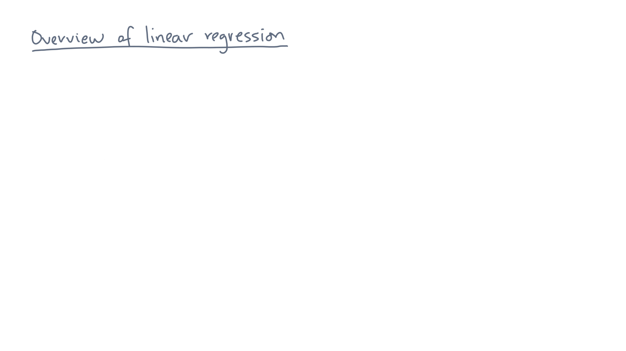
Notes:
Ok, so let’s get started.

Slide 5
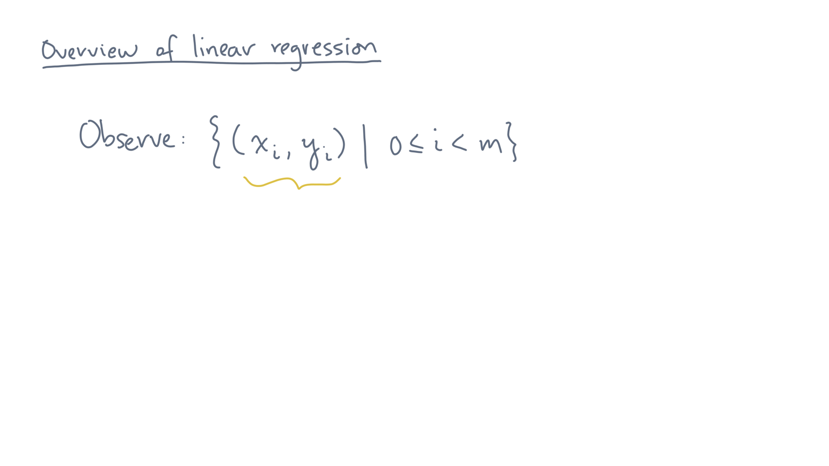
Notes:
Consider a set of observations made up of pairs of values, x-eye, y-eye.

Slide 6
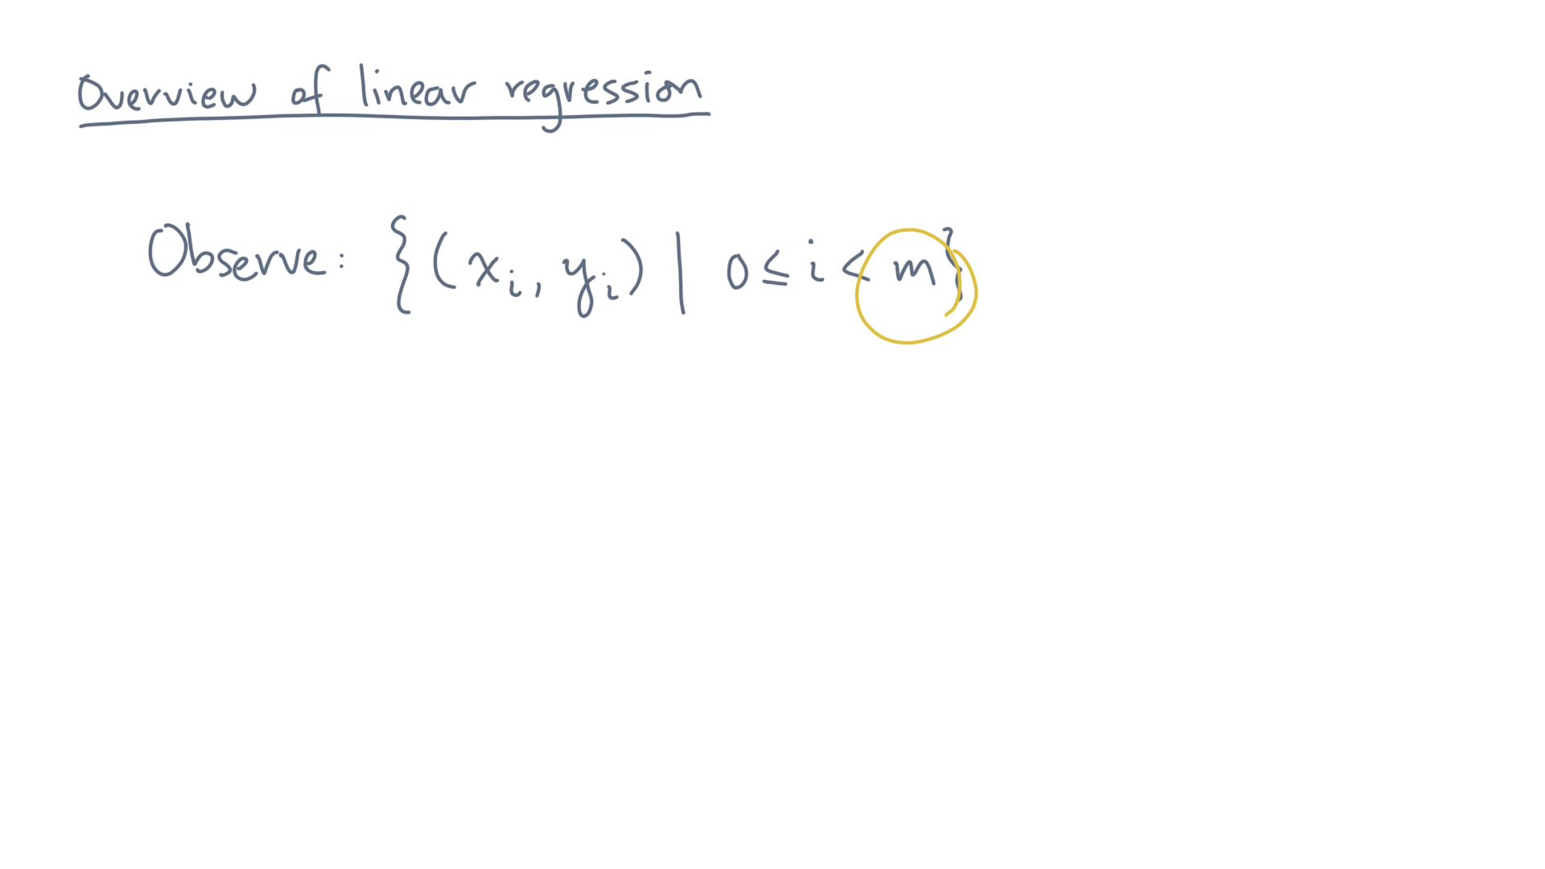
Notes:
Suppose there are “m” such points.

Slide 7
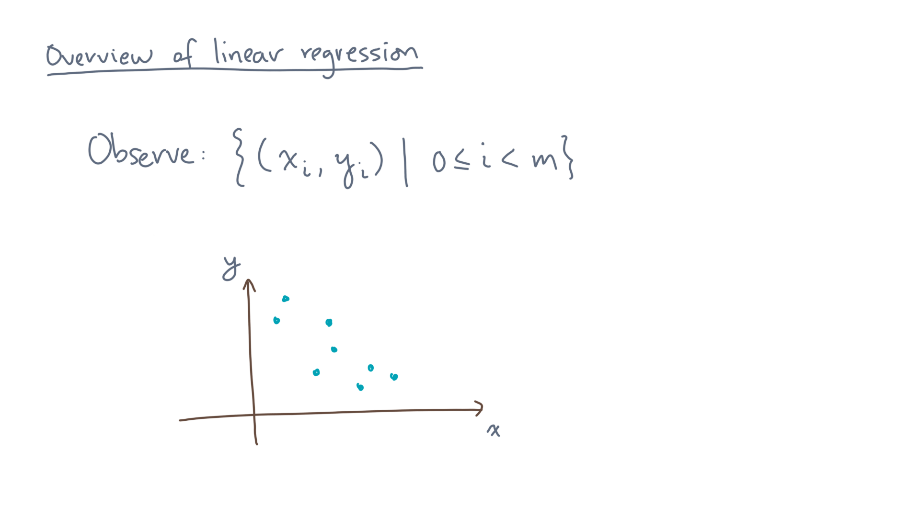
Notes:
If the values are continuous, we can make an two-dimensional, x-y scatter plot of these pairs.

Slide 8
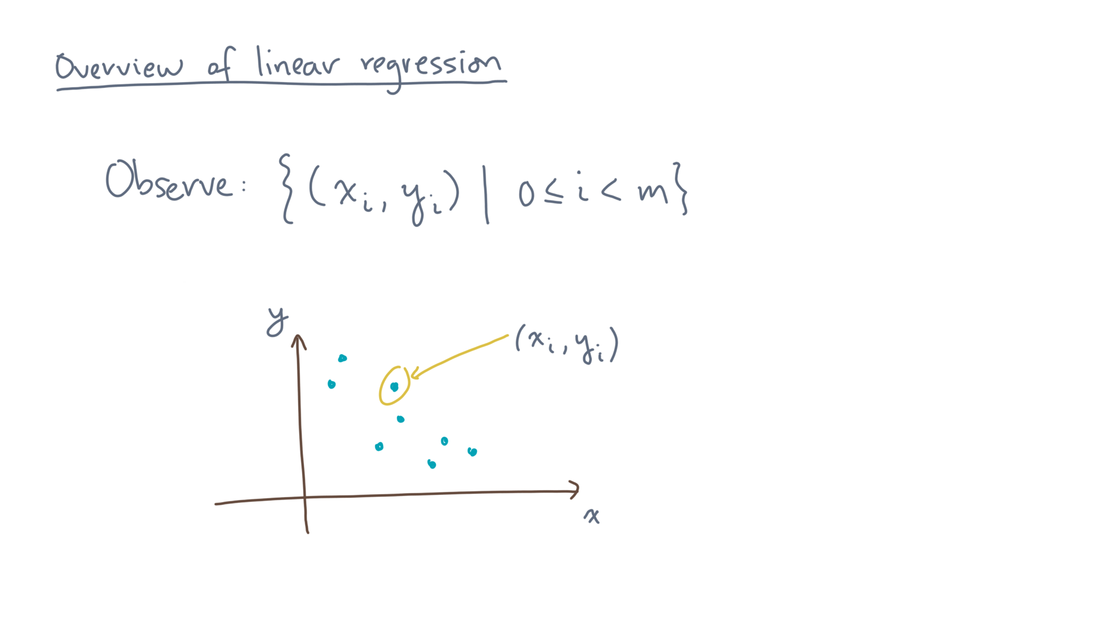
Notes:
Each point in the scatter plot is an observation.

Slide 9
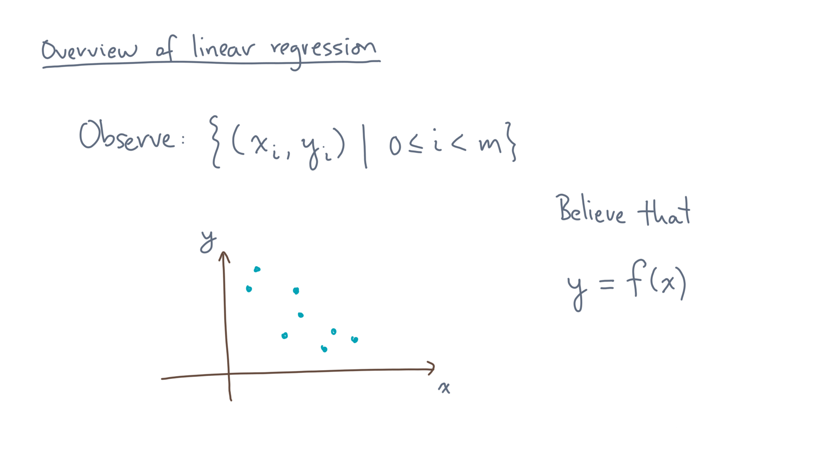
Notes:
Now, in general we believe there is some model that can represent these data.
Let’s think of that as some mathematical function, f, that maps some input value x to an output y.

Slide 10
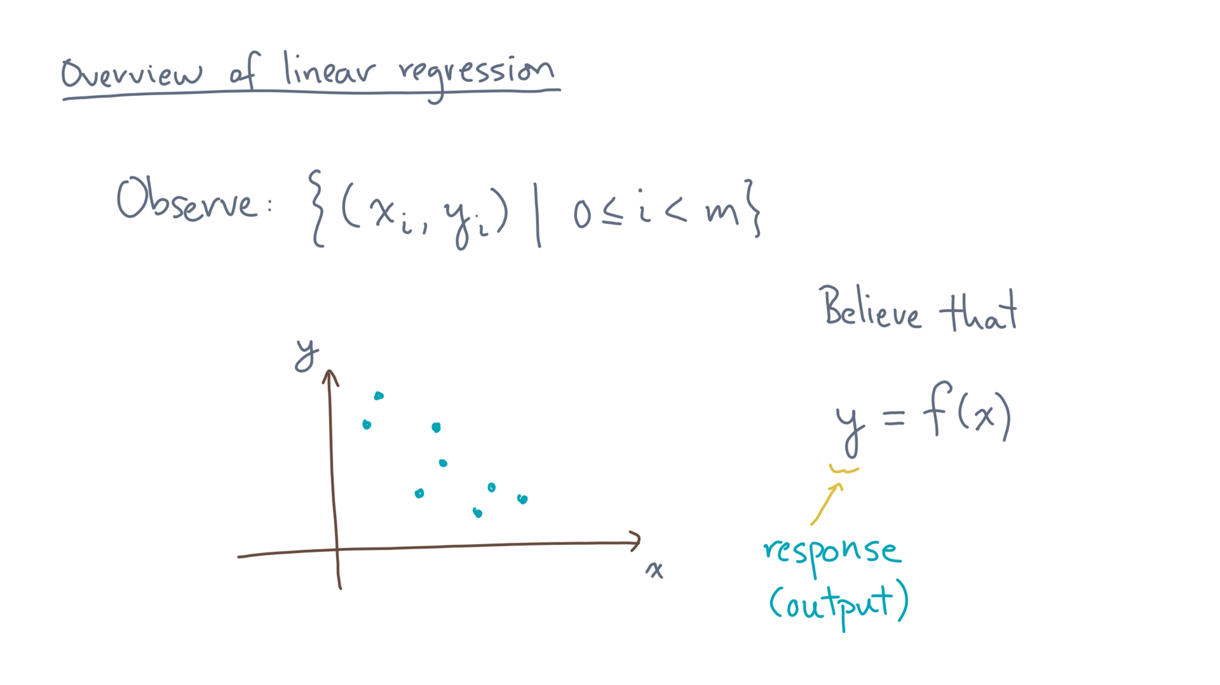
Notes:
Let’s refer to the output, y, as the “response variable,” or just “response.”

Slide 11
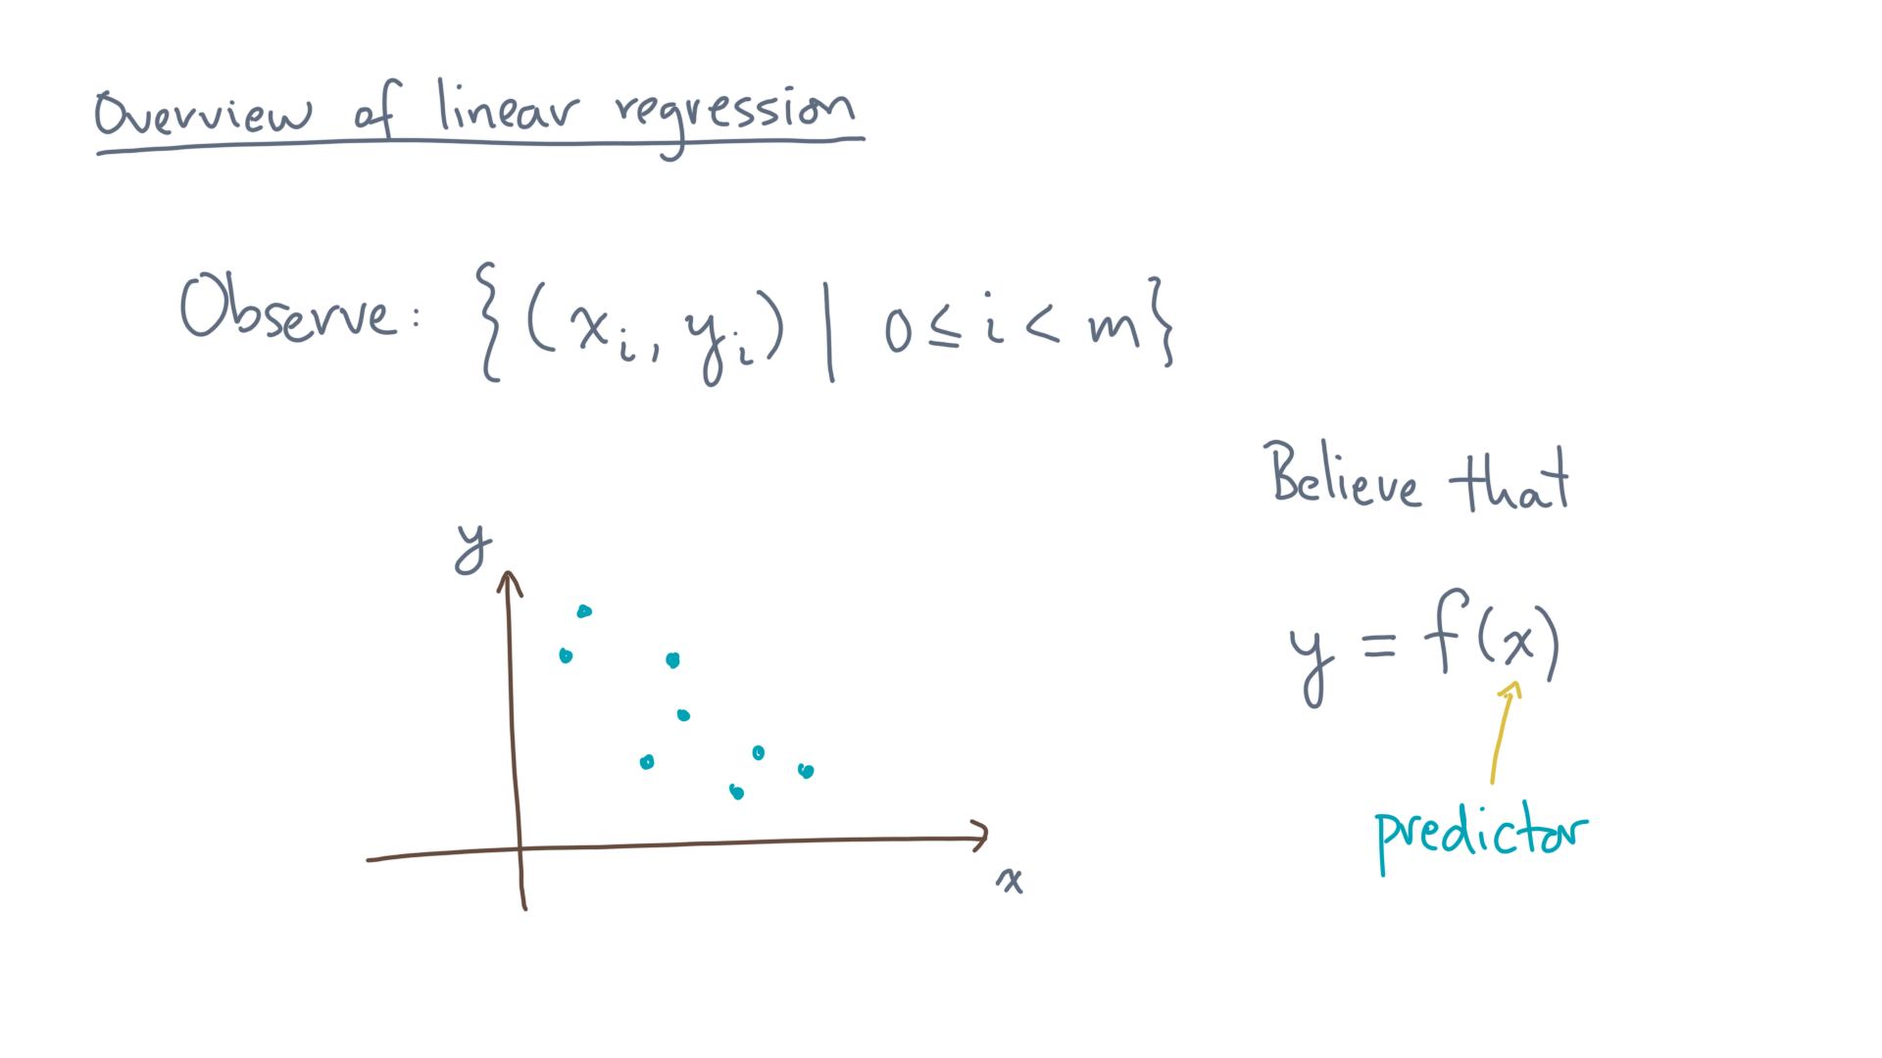
Notes:
And let’s call the input variable “x” the “predictor.”

Slide 12
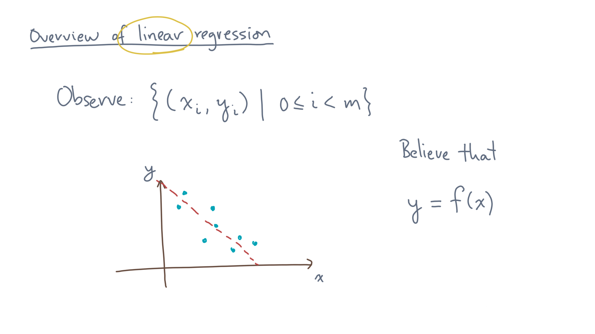
Notes:
For these data, it looks like a “line” might be a good model.

Slide 13
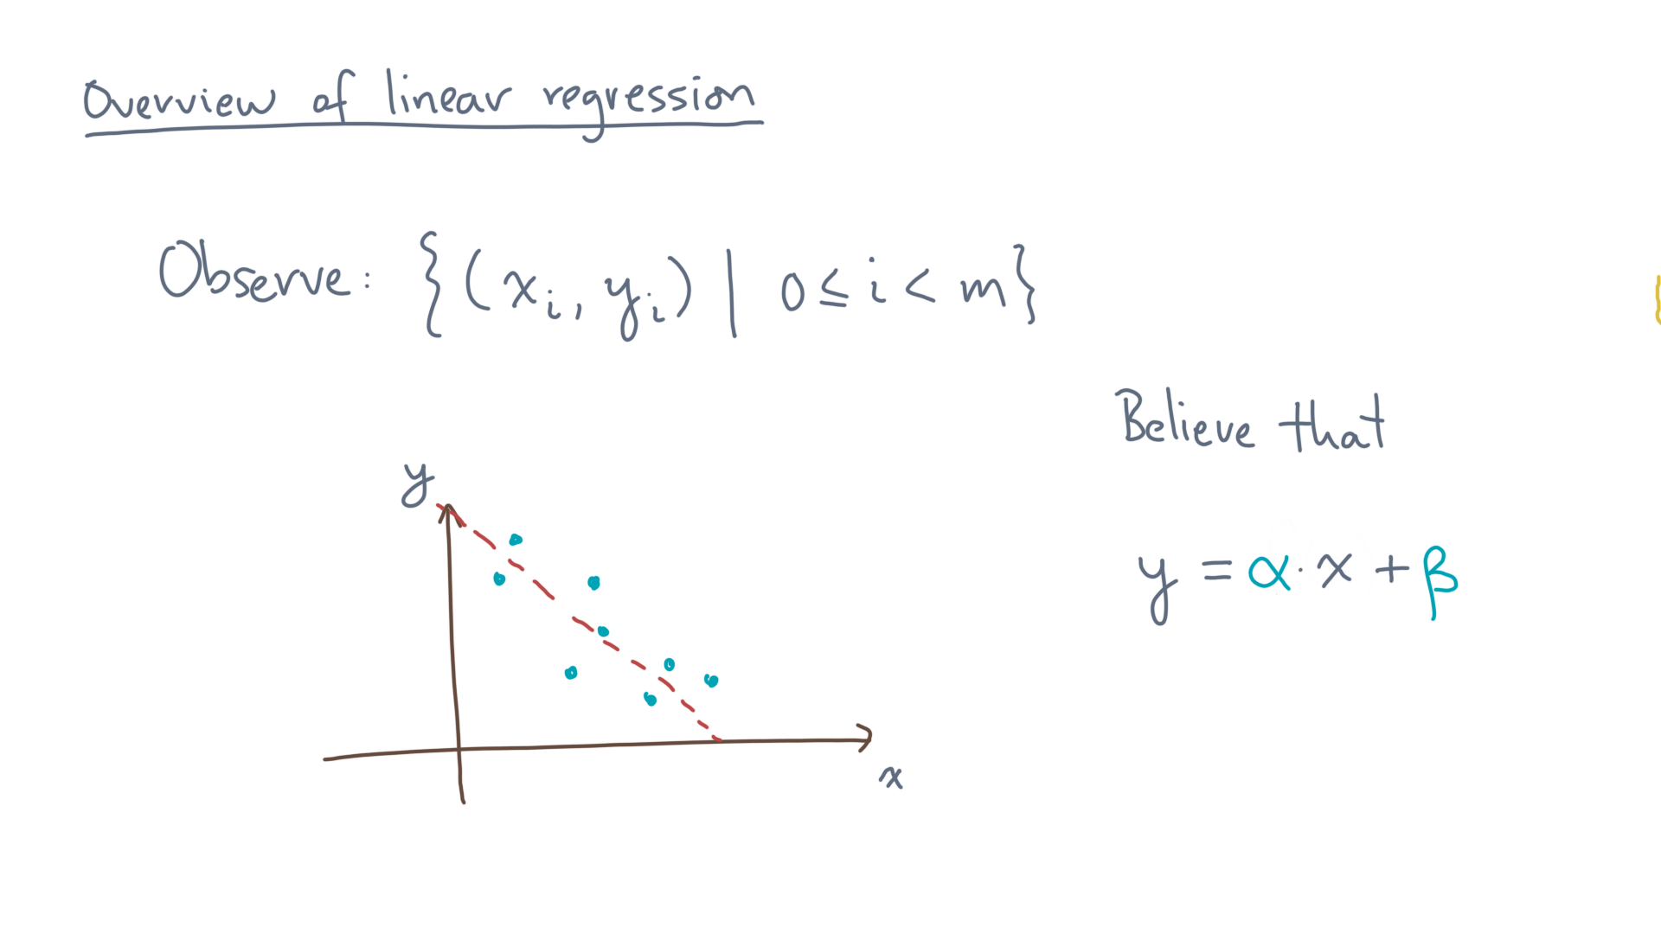
Notes:
And here is a formula for such a linear model: y equals alpha times x plus beta.

Slide 14
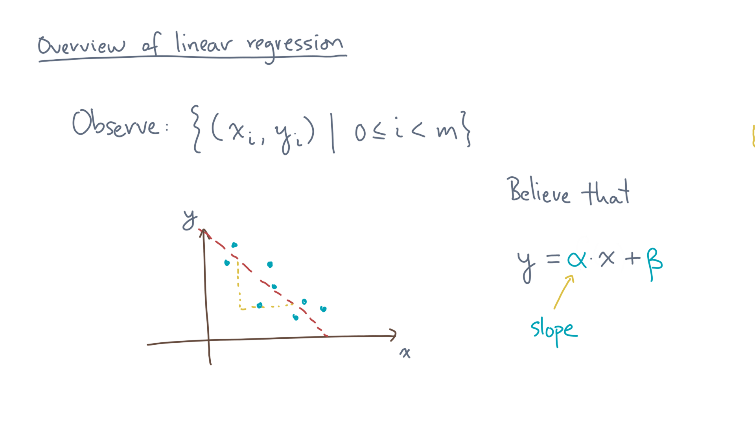
Notes:
The coefficient “alpha” measures the slope of this line.

Slide 15
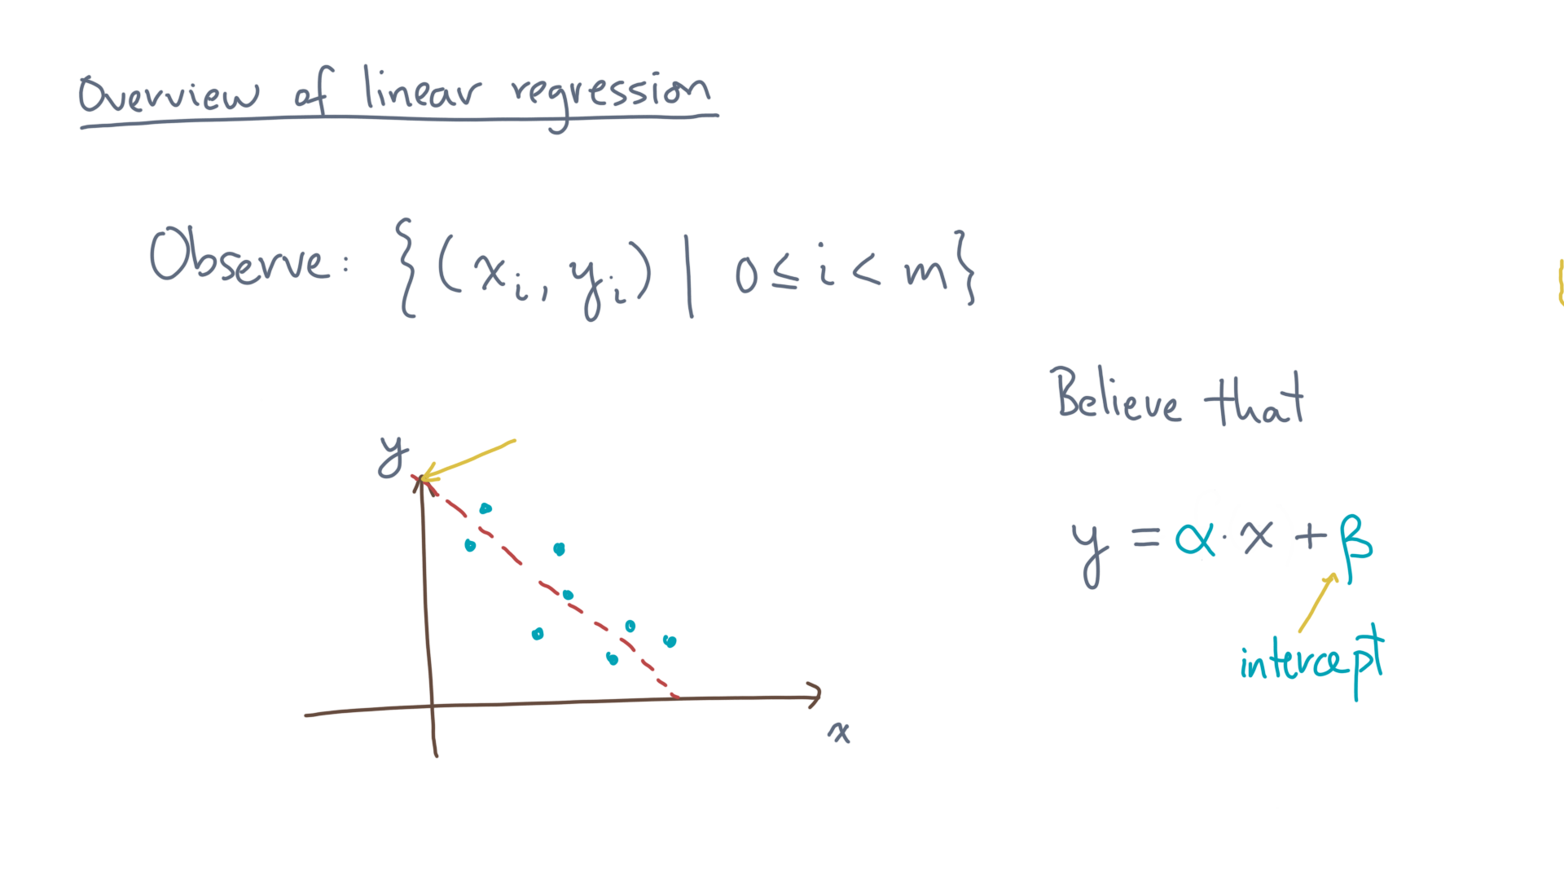
Notes:
The parameter “beta” is the y-intercept.

Slide 16
Notes:
Of course, this is just a cartoon.
So let’s switch over to a notebook to look at some real data.

Slide 17
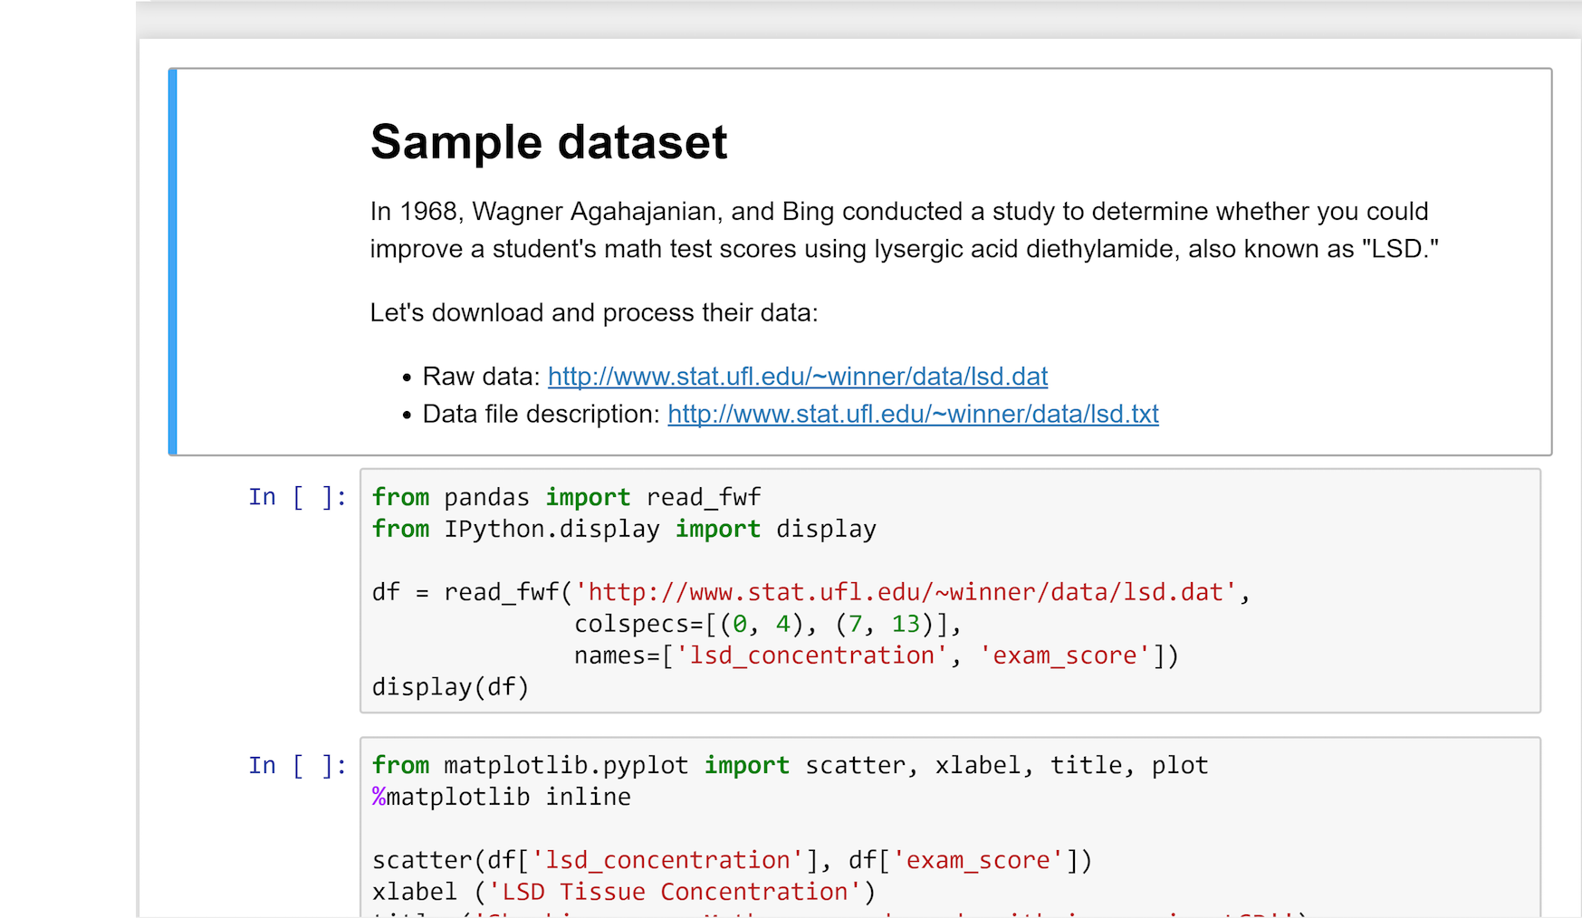
Notes:
This notebook is based on a 1968 study by Wagner, Aga-ha-ja-nian, and Bing.

Slide 18
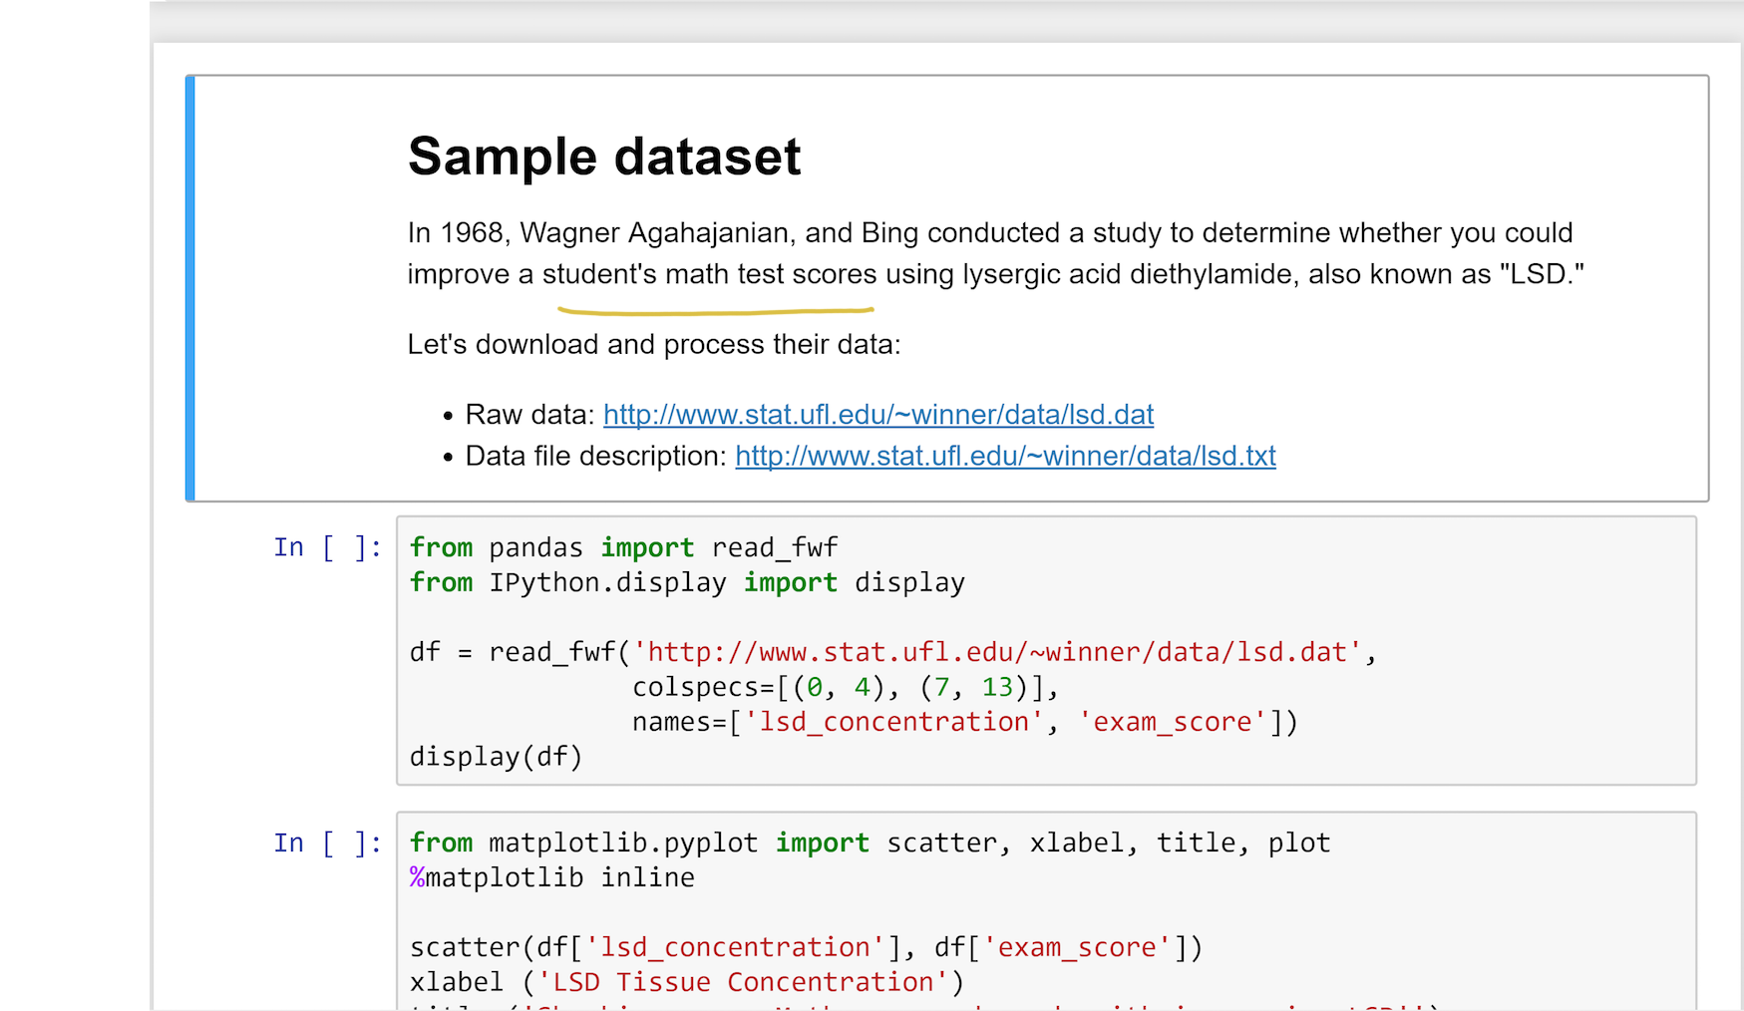
Notes:
They measured math test scores for seven students.
So these scores are the “output.”

Slide 19
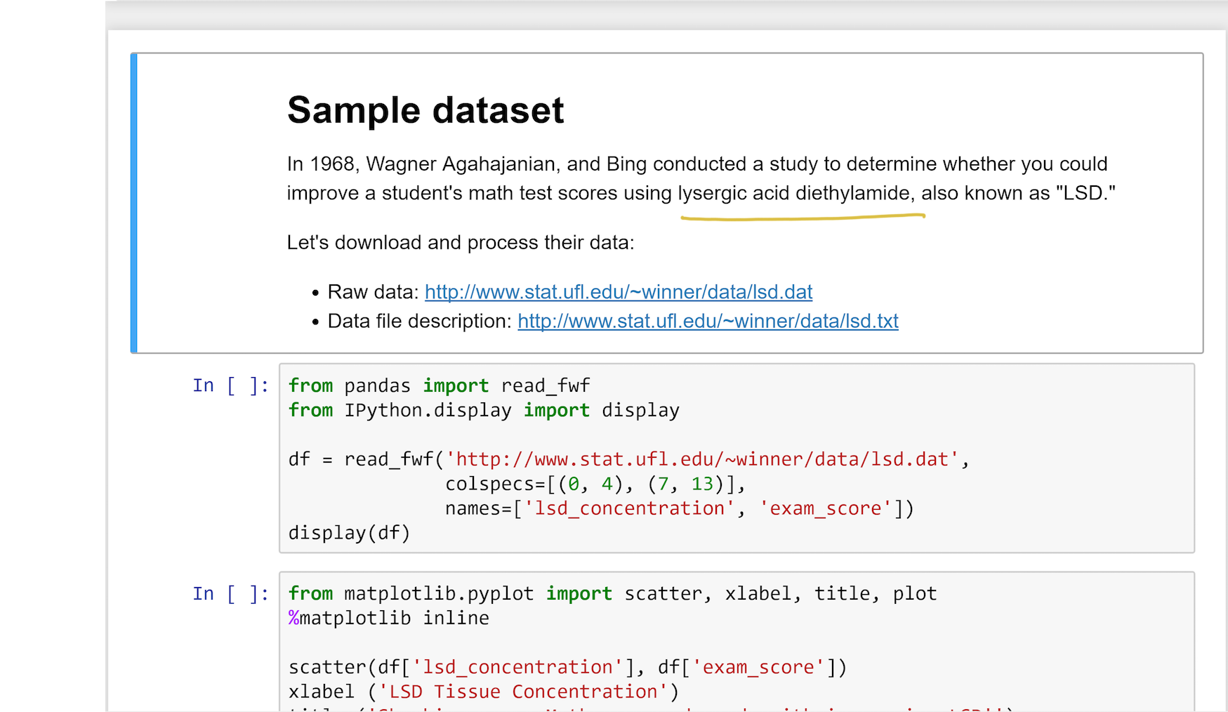
Notes:
And they gave each student differing amounts of lysergic acid die-thy-la-mide.

Slide 20
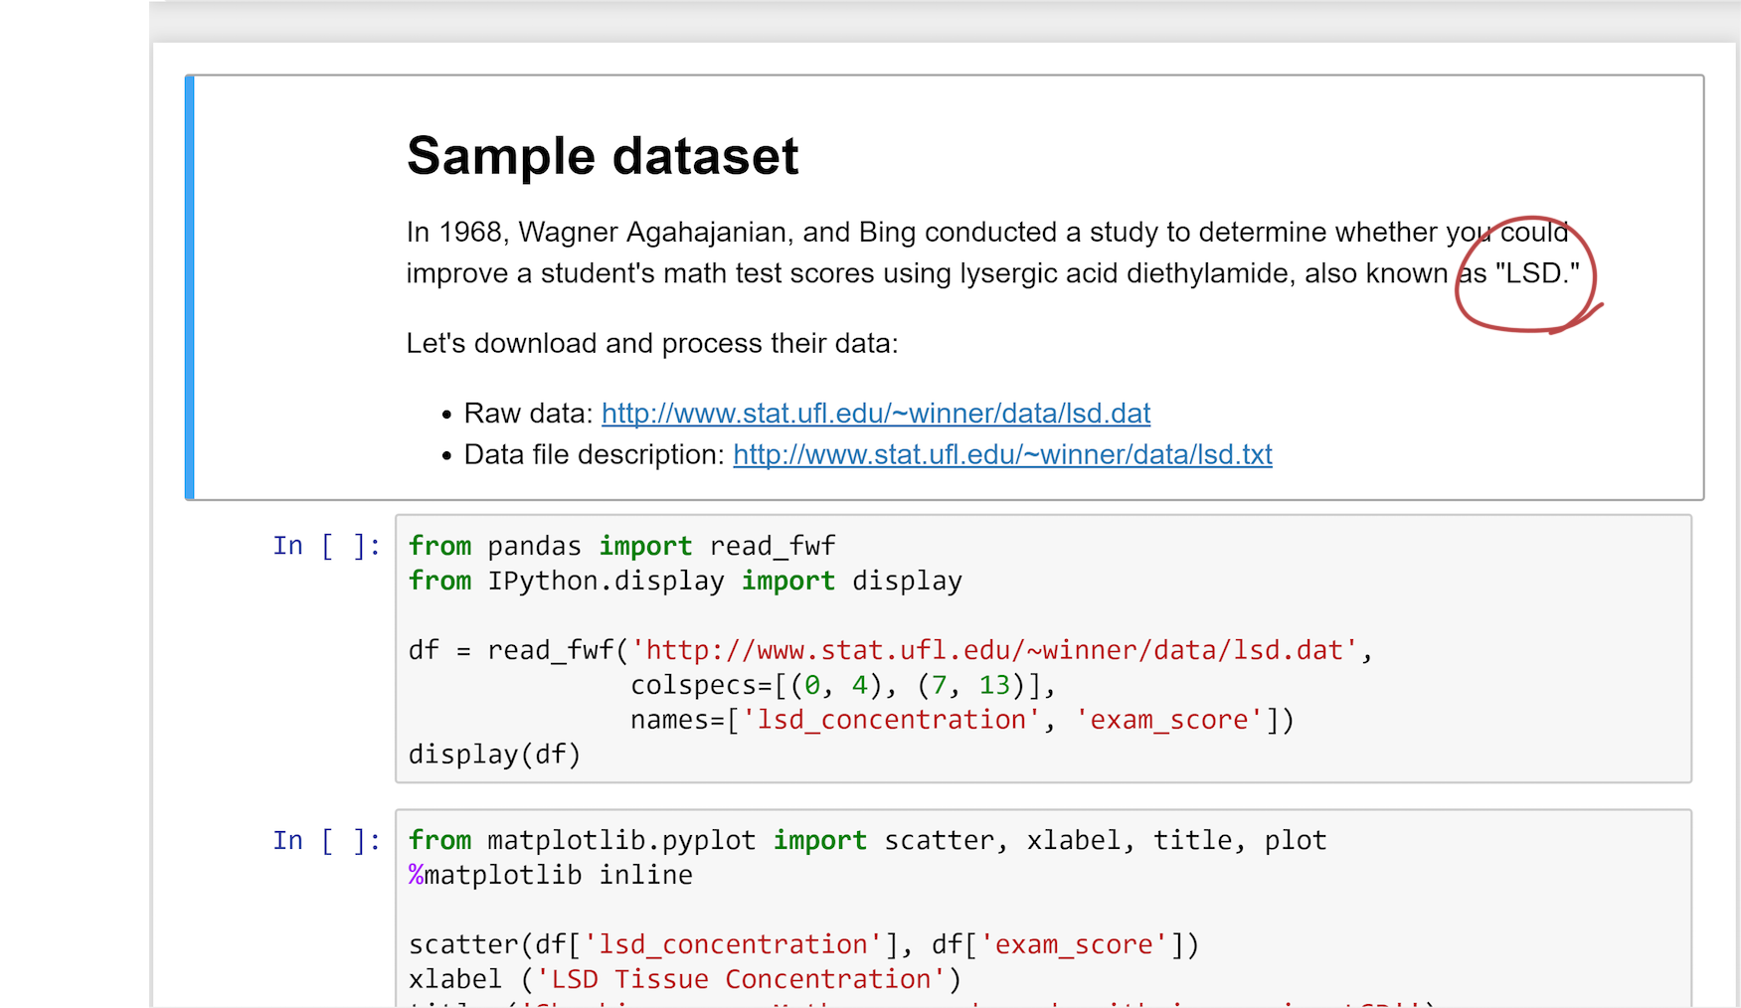
Notes:
That’s L-S-D for short.
And yes, scientific studies in the 60s were, arguably, a lot more … “interesting” … than they are today.

Slide 21
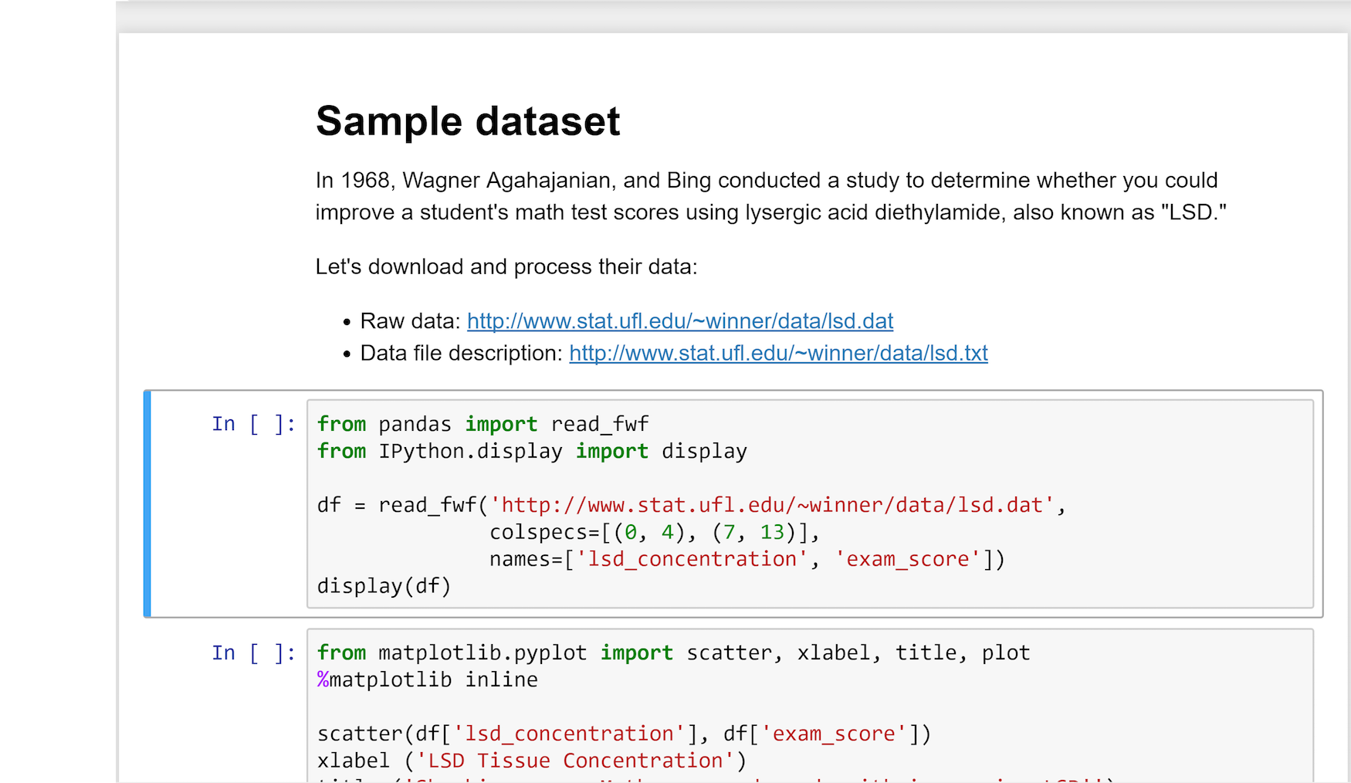
Notes:
Let’s turn to the first code cell.

Slide 22

Notes:
It first downloads the raw data.

Slide 23
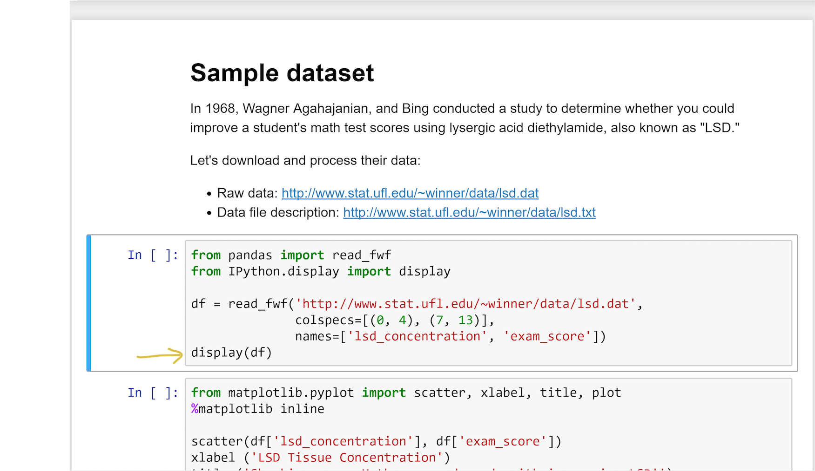
Notes:
It then displays it.

Slide 24
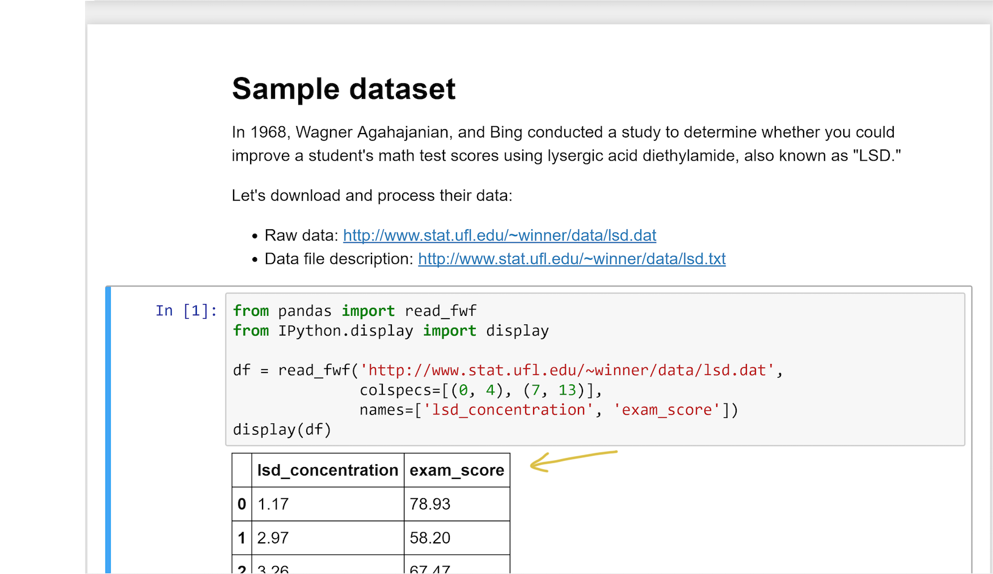
Notes:
Here is the output data frame.

Slide 25
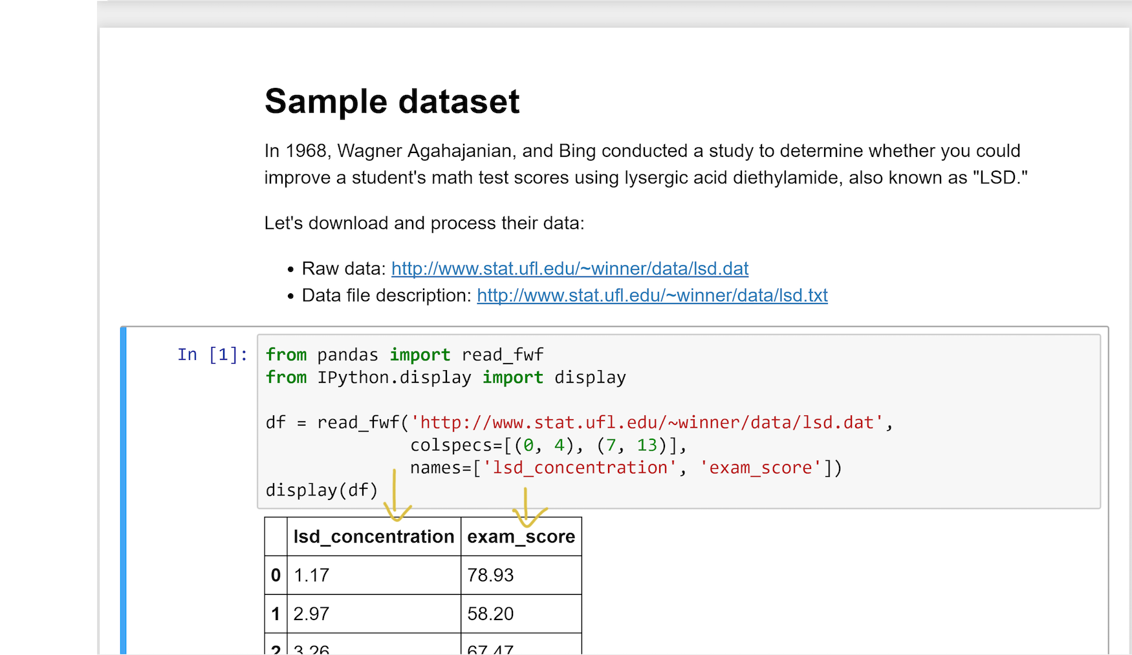
Notes:
It’s a tibble whose two columns are the observed values of the response and predictor variables.

Slide 26
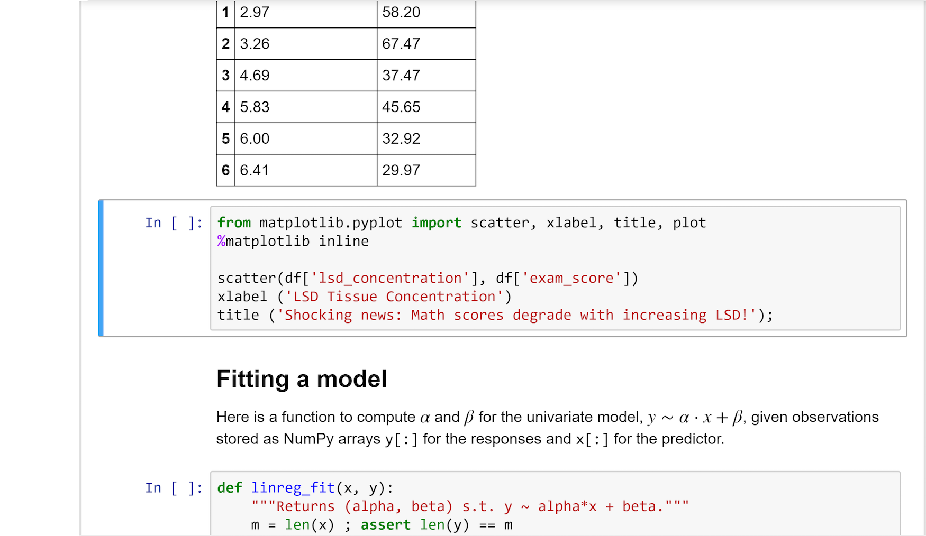
Notes:
Let’s move to the next cell.

Slide 27
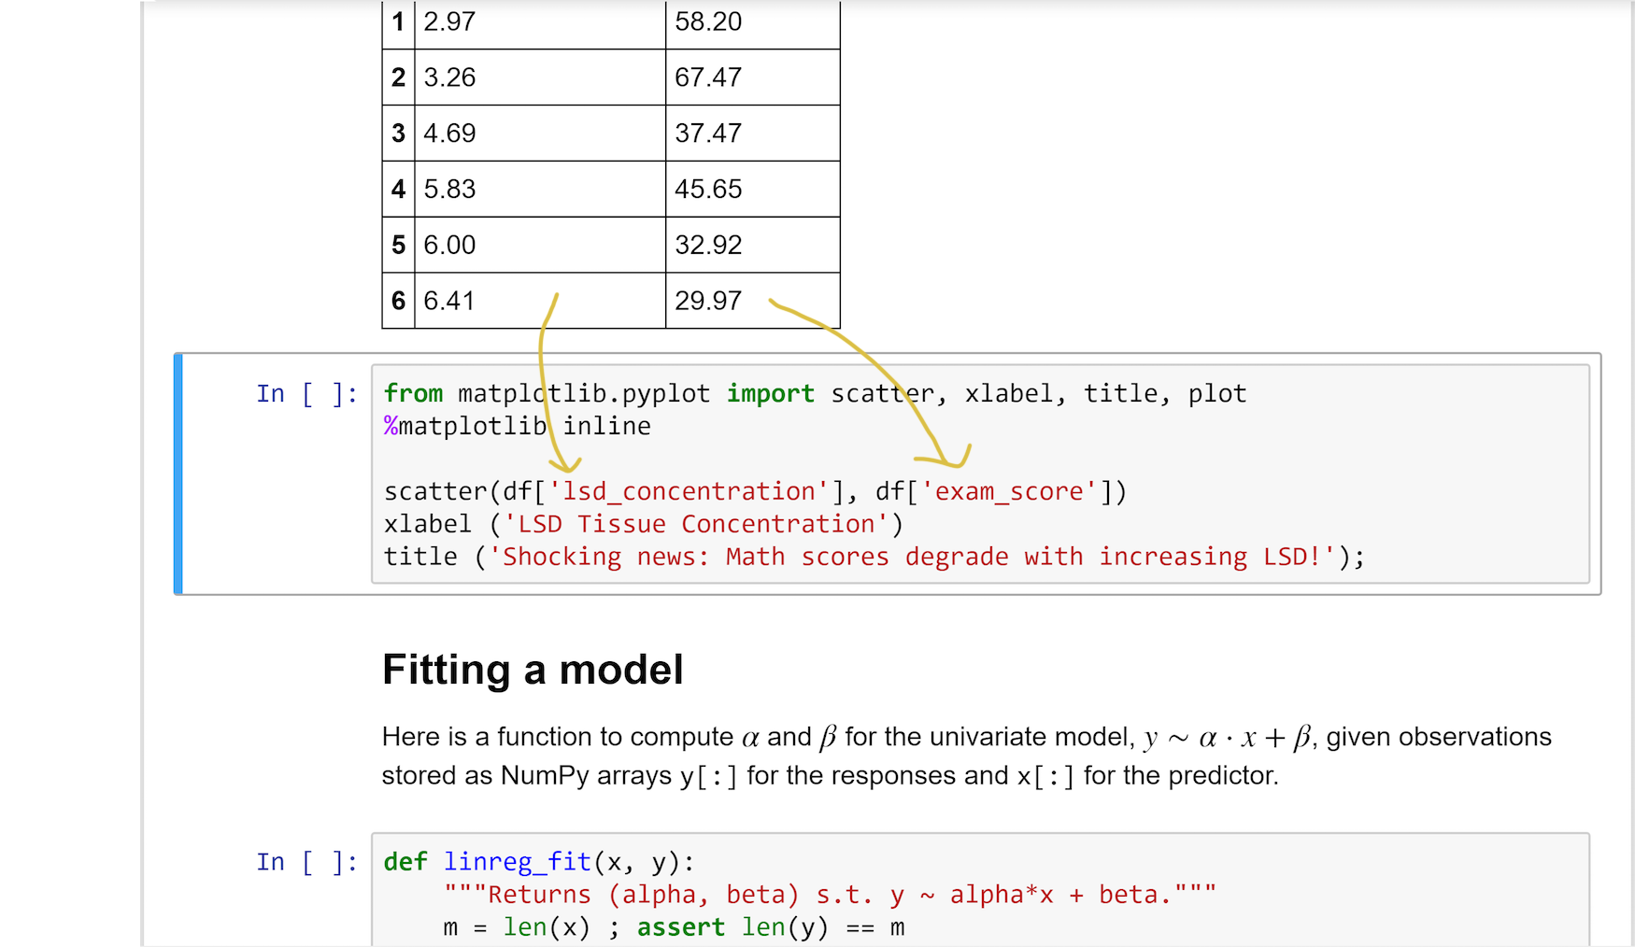
Notes:
It takes these two variables.

Slide 28
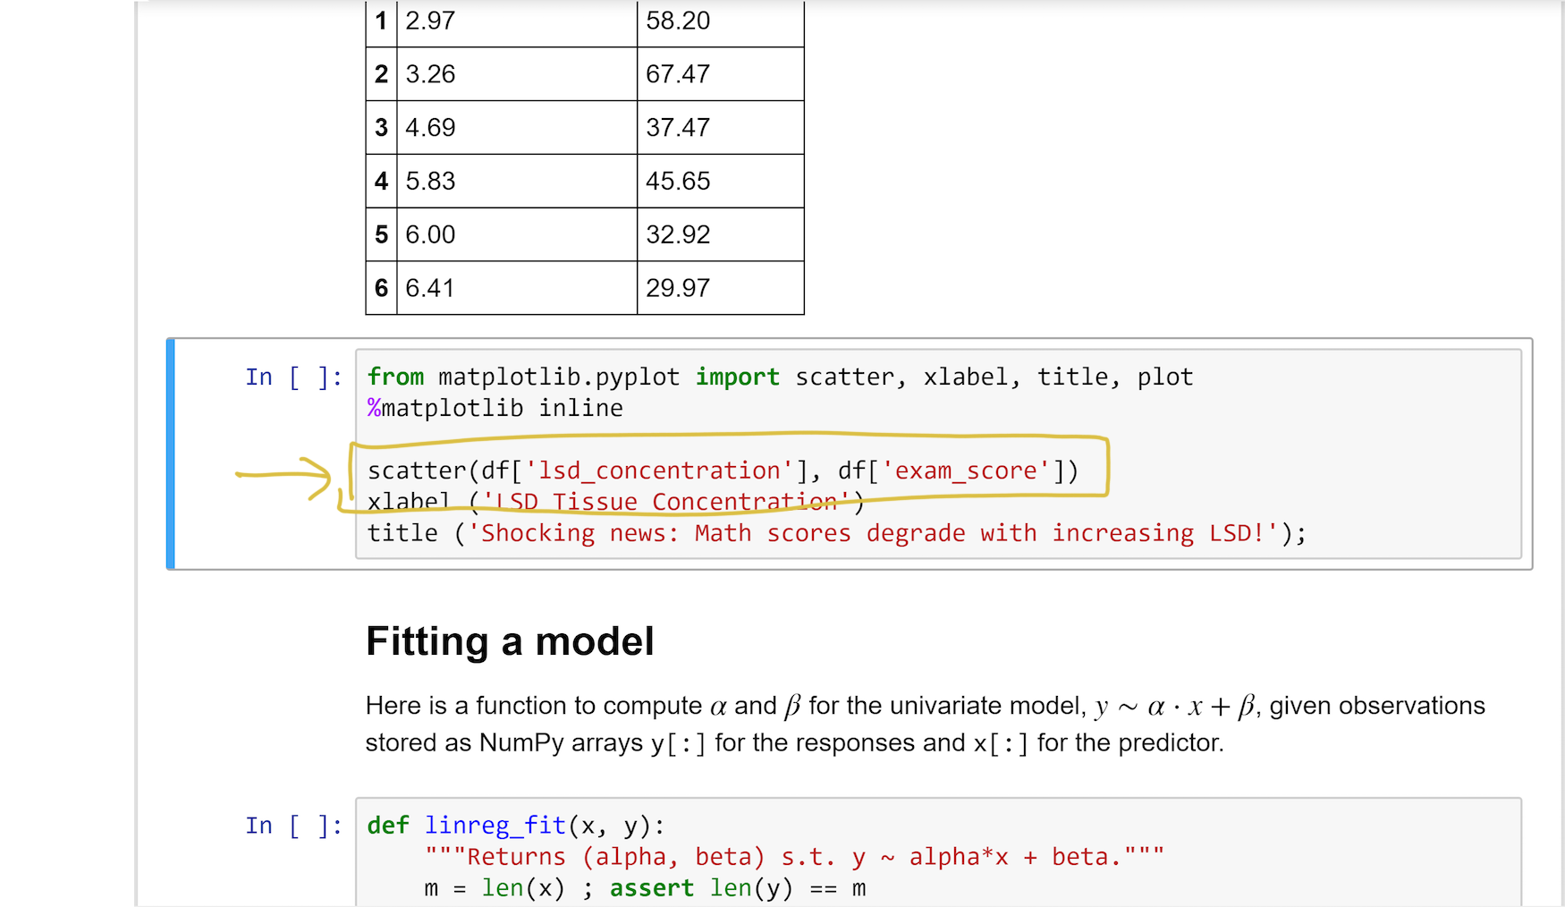
Notes:
It then creates a simple 2-D scatter plot of the data.

Slide 29
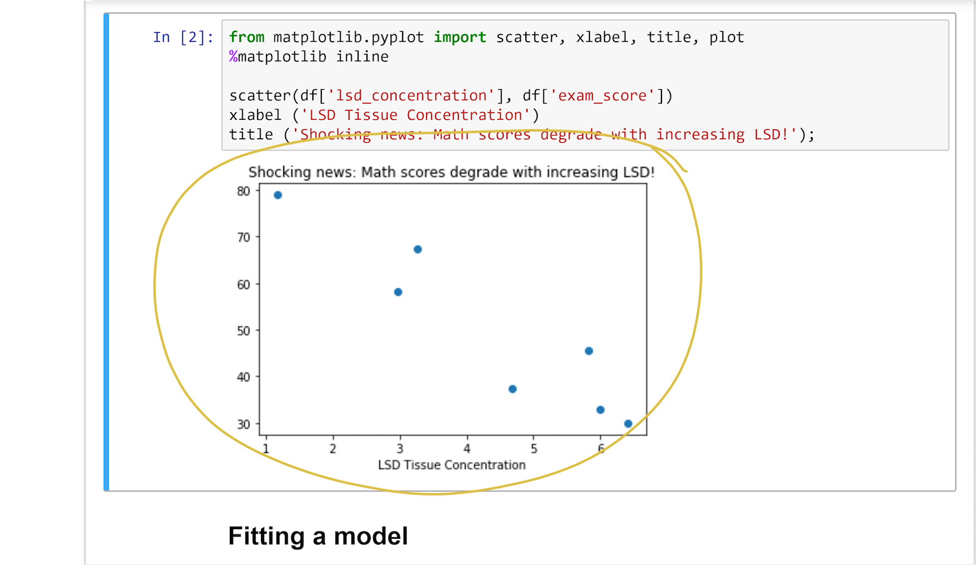
Notes:
And here is the output.
Lo and behold, the higher the concentration of LSD in a student’s tissue, the lower his or her test score.
Keep that in mind for this class’s final exam.

Slide 30
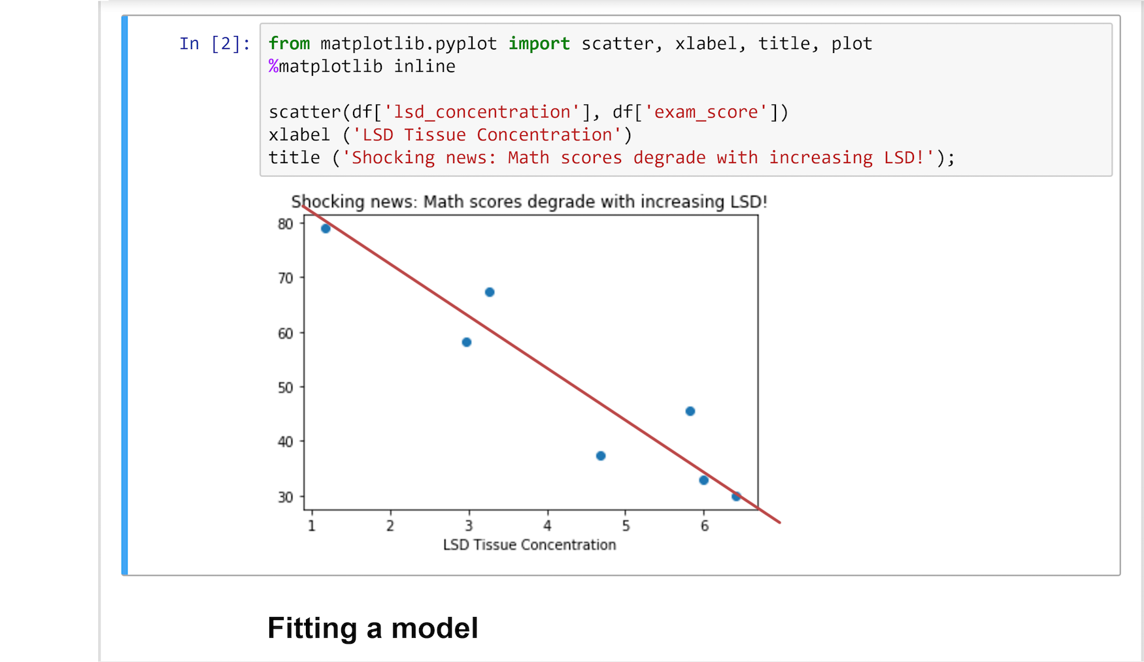
Notes:
And assuming you are not under the influence, you’ll see that a straight line might be a groovy model for this dataset.

Slide 31
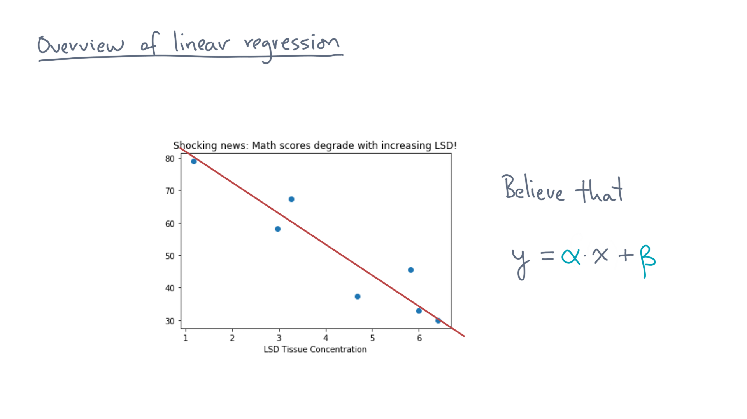
Notes:
Now there are many lines you could have tried to draw through these points, so which one is best?

Slide 32
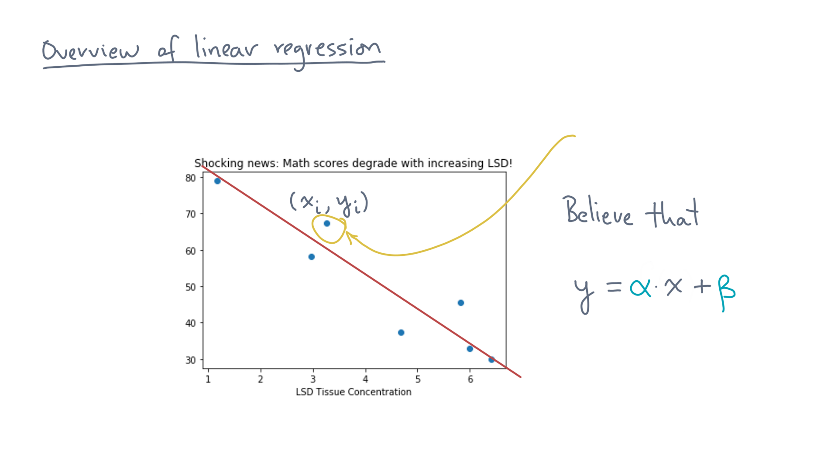
Notes:
Consider some data point, x-eye, y-eye.

Slide 33
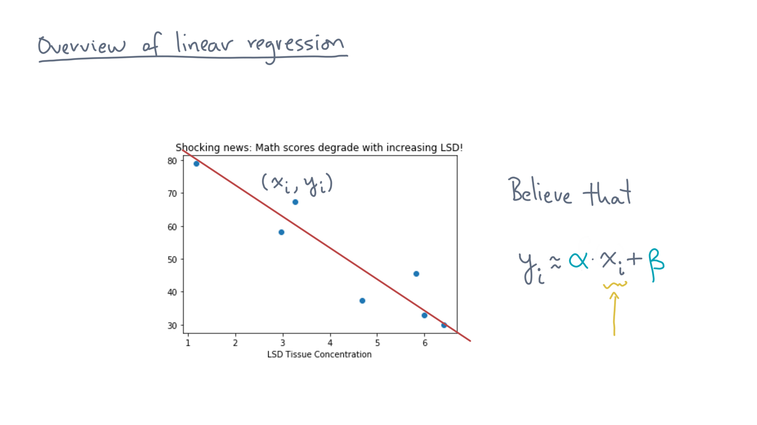
Notes:
Plugging the value of “x-eye” into the model produces, at best, some approximation of the true output value, “y-eye.”

Slide 34
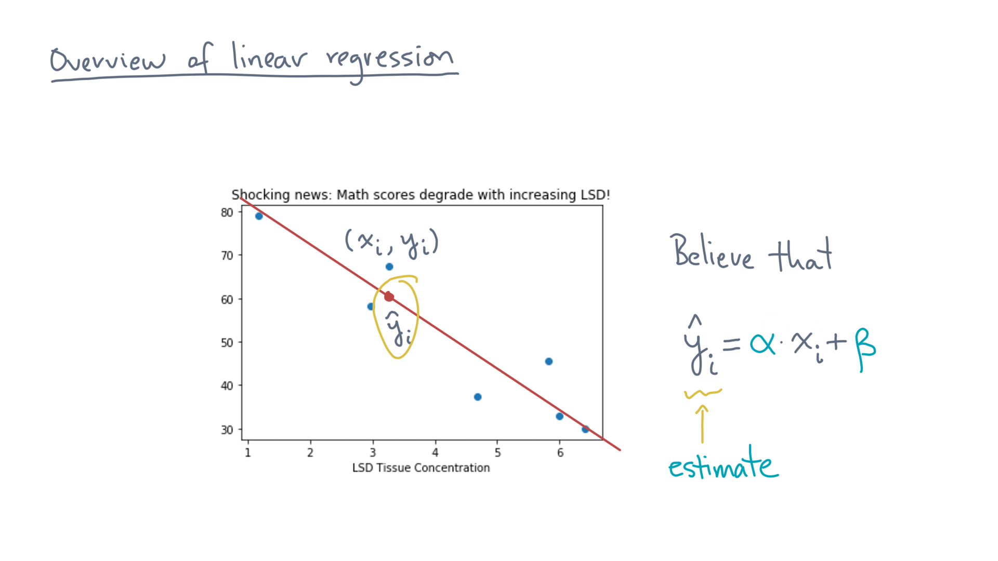
Notes:
Let’s call that model output, y-eye-hat.
It’s our model’s *estimate* of the true value, y-eye.

Slide 35
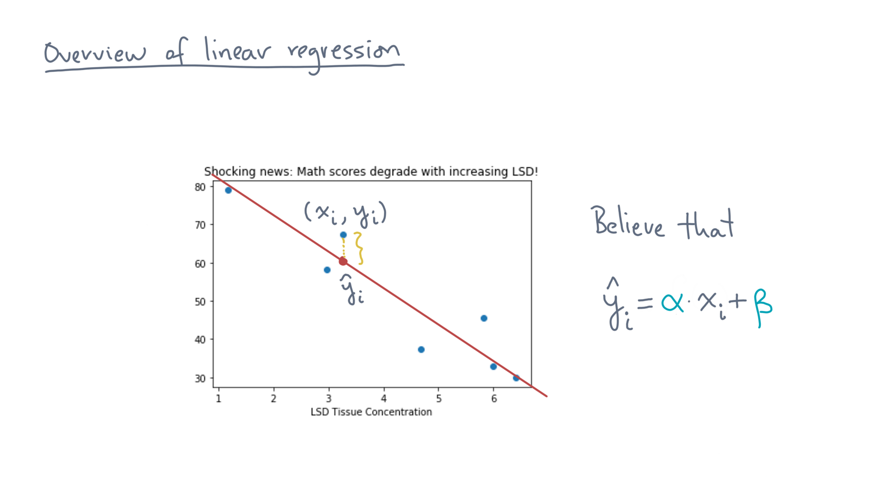
Notes:
So how good is this estimate?
Let’s measure the difference.

Slide 36
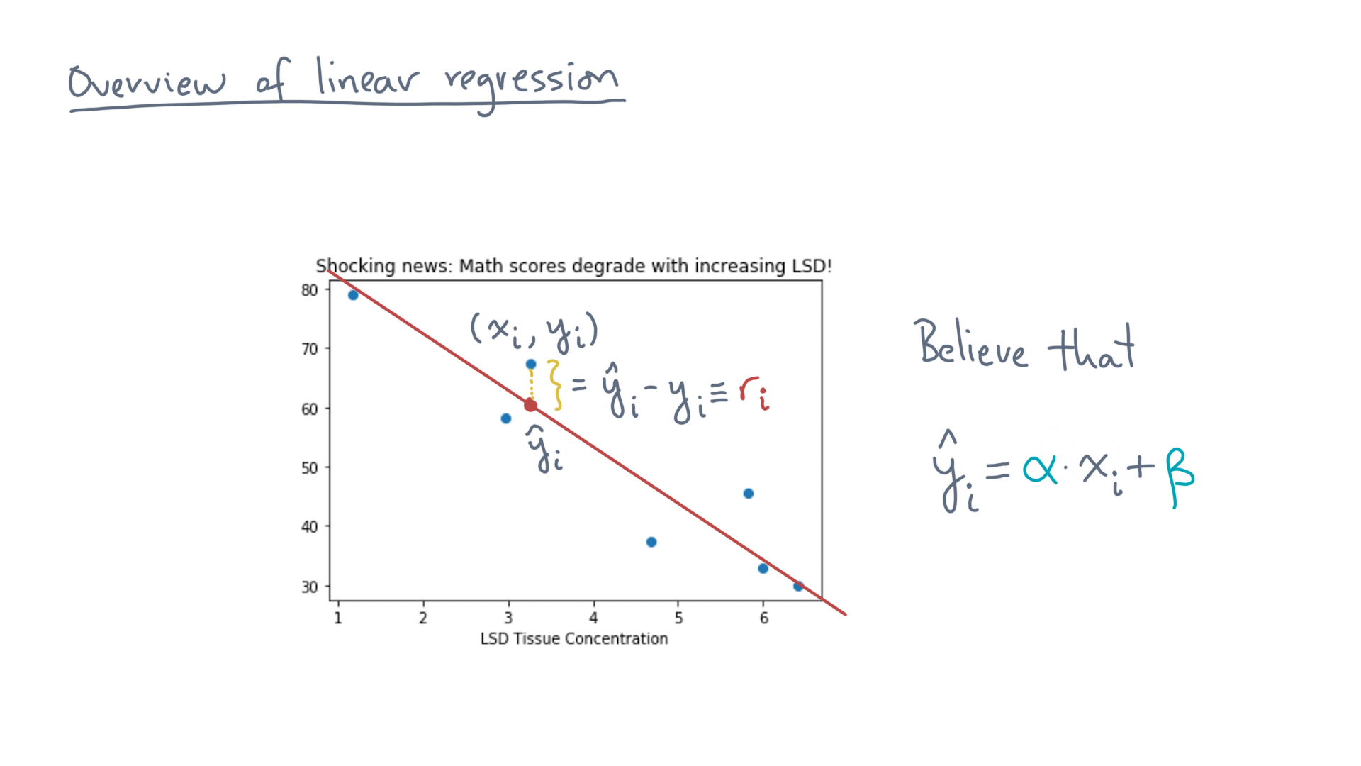
Notes:
Consider the difference, y-eye-hat minus y-eye.
Let’s call that r-eye.

Slide 37
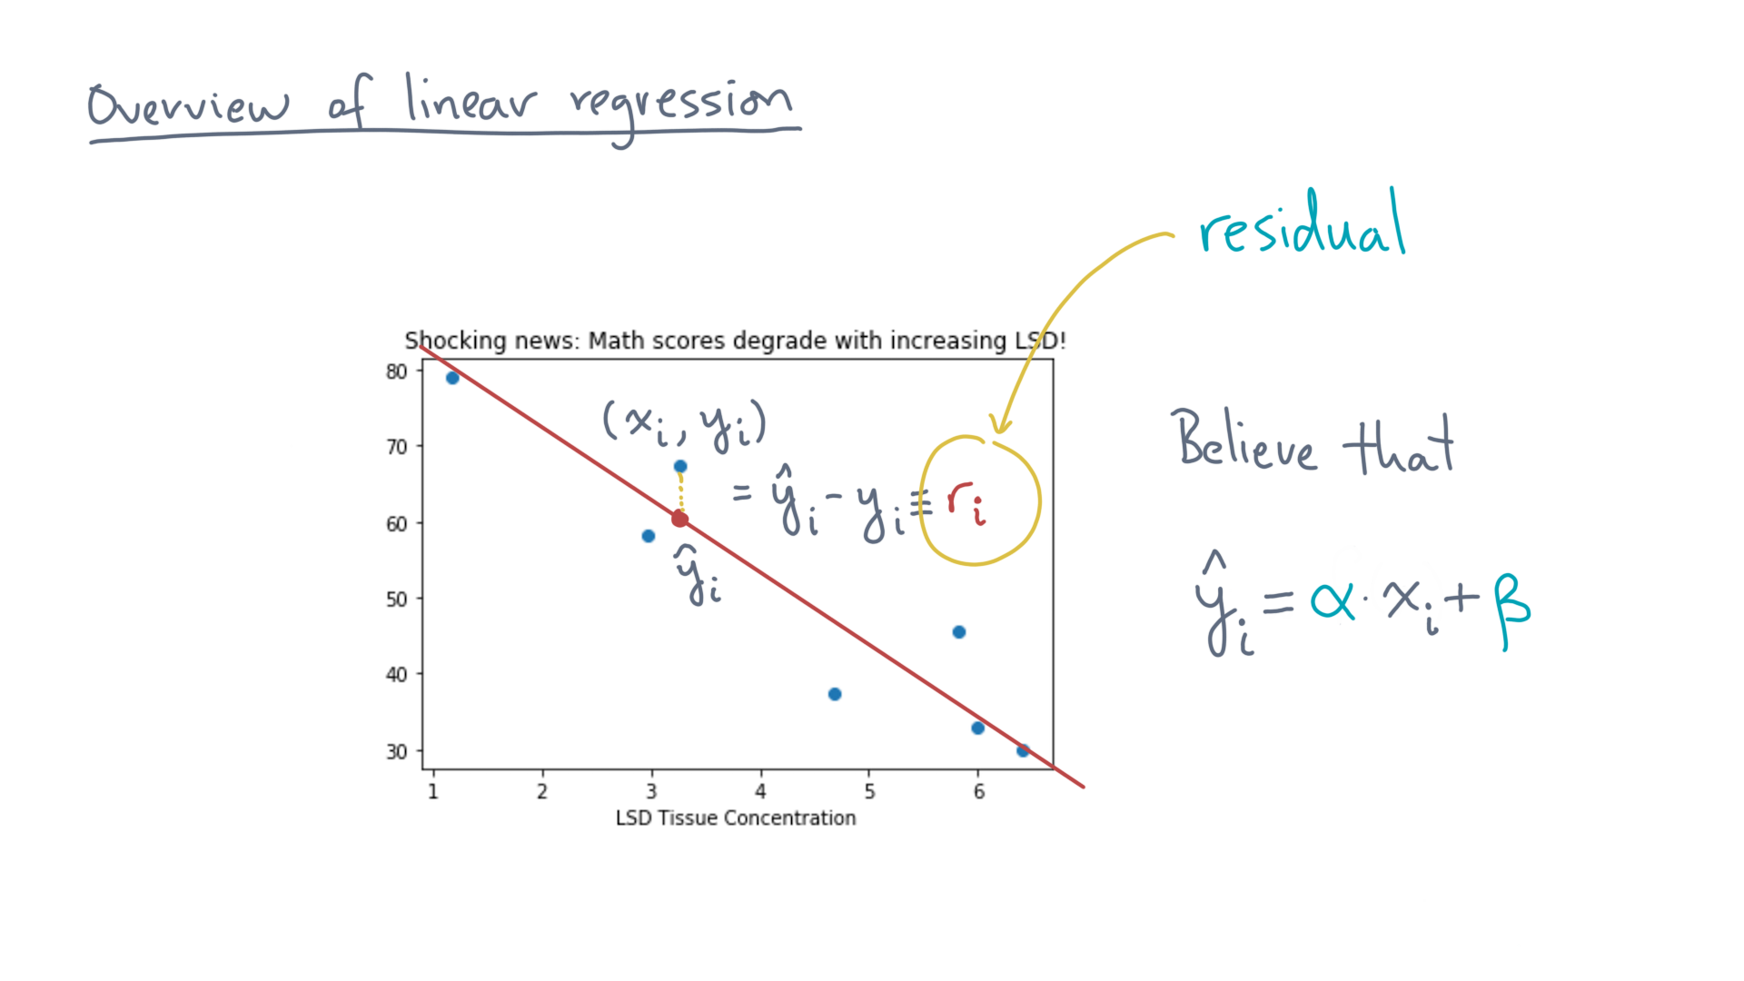
Notes:
It’s also known as the *residual* at x-eye.
Think of it as the error in the model’s prediction relative to the observed value.

Slide 38
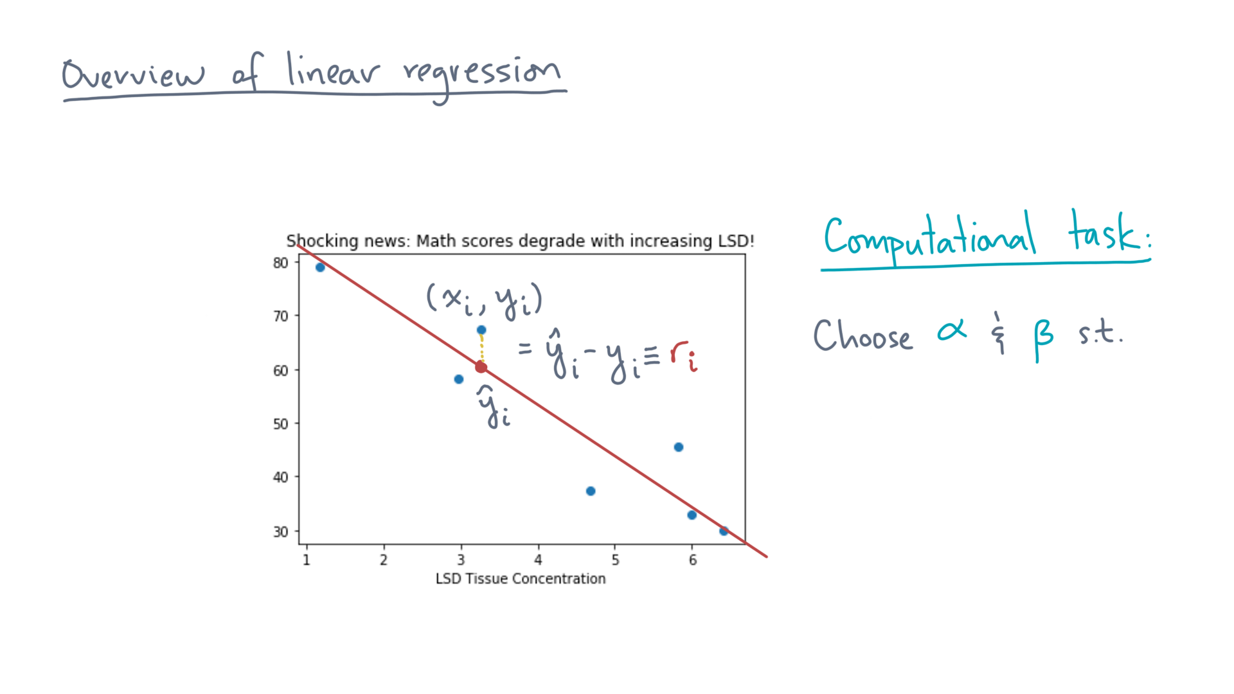
Notes:
We can now define our computational task.
Start with a residual, r-eye.

Slide 39

Notes:
Now consider squaring it.

Slide 40

Notes:
Intuitively, squaring the residual has the effect of significantly amplifying big residuals.

Slide 41
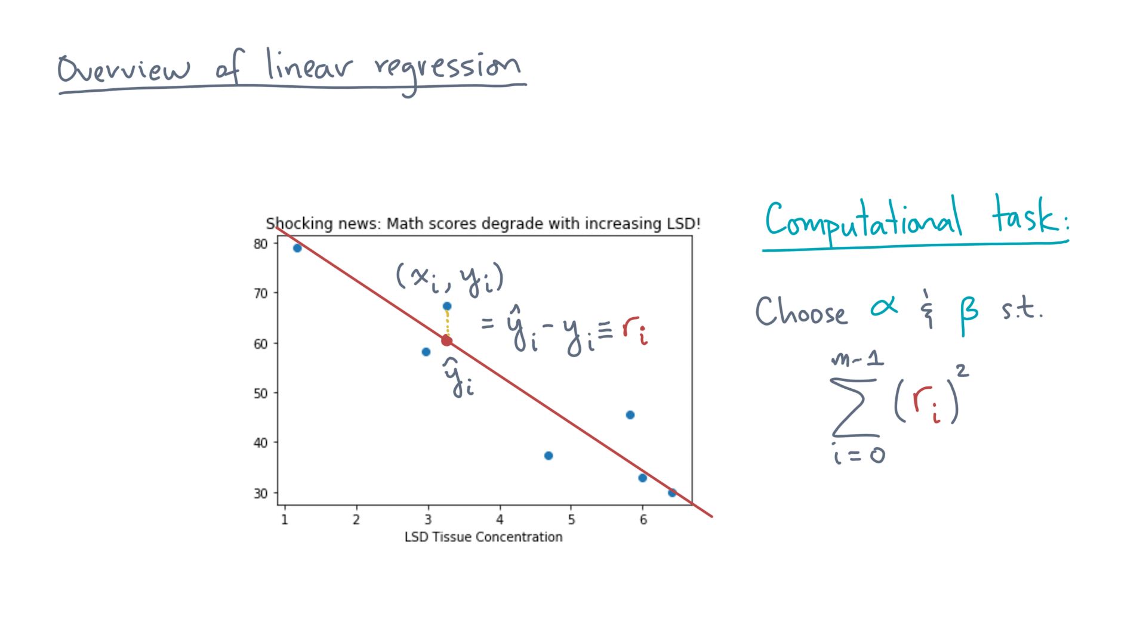
Notes:
Now sum all the residuals.

Slide 42
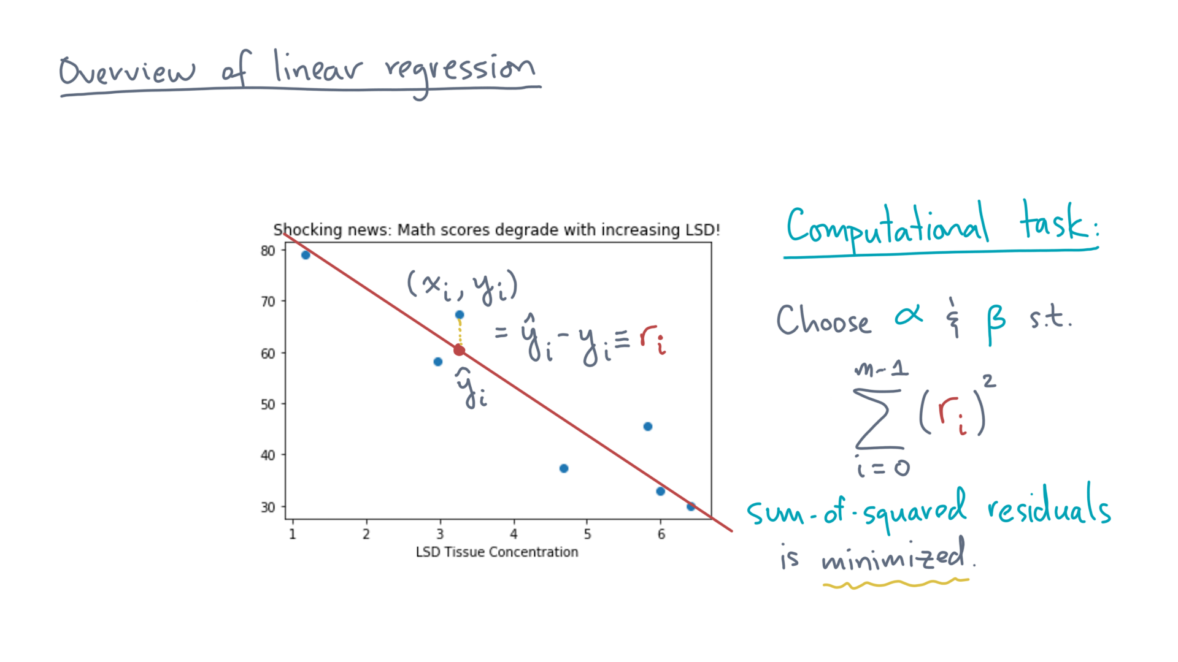
Notes:
Let’s try to choose the model parameters, alpha and beta, to *minimize* this quantity, which is the sum-of-squared residuals.

Slide 43

Notes:
This is the linear regression problem.

Slide 44
Notes:
I started this lesson by saying we would approach the problem of linear regression in an “ad hoc” way.
The “ad hoc” part is the objective function.
Why minimize the sum-of-squared residuals, as opposed to, say the absolute values of the residuals, or something even higher than squares?

Slide 45
Notes:
One reason is that there is a rigorous statistical interpretation, which you may have already seen or will soon see in a different class.
A second is that, as we’ll see, the math needed to solve the problem works out nicely for this function.

Slide 46
Notes:
But a third reason is that solving the optimization problem will yield an algorithm.
So take a moment to review this topic, preferably while sober, and when you are ready let’s see how to get there.

